Slide 1


SHANMUGANATHAN ENGINEERING COLLEGE (Accredited by NAAC, an ISO 9001:2015 Certified Institution) ARASAMPATTI – 622 507 DEPARTMENT OF ELECTRONICS AND COMMUNICATION ENGINEERING
NAAN MUDHALVAN PRESENTATION
Title : Build a RESTful API for a blogging platform
Presented by,
A.Sujitha (912421106016)
B.Swathi (912421106017)

Slide 2

Building a RESTful API for a Blogging Platform
This presentation will guide you through the process of building a RESTful API for a blogging platform.
We'll cover the essential concepts, design principles, and implementation details needed to create a robust and scalable API.

Slide 3
Introduction to RESTful APIs
1
Architectural Style
2
Resource-Oriented
RESTful APIs adhere to the Representational State Transfer (REST) architectural style, which emphasizes stateless communication and the use of standard HTTP methods.
RESTful APIs treat data as resources, each with a unique identifier and a set of associated operations.
3
Uniform Interface
RESTful APIs utilize a consistent interface, allowing clients to interact with resources in a predictable way using HTTP verbs and standard headers.

Slide 4
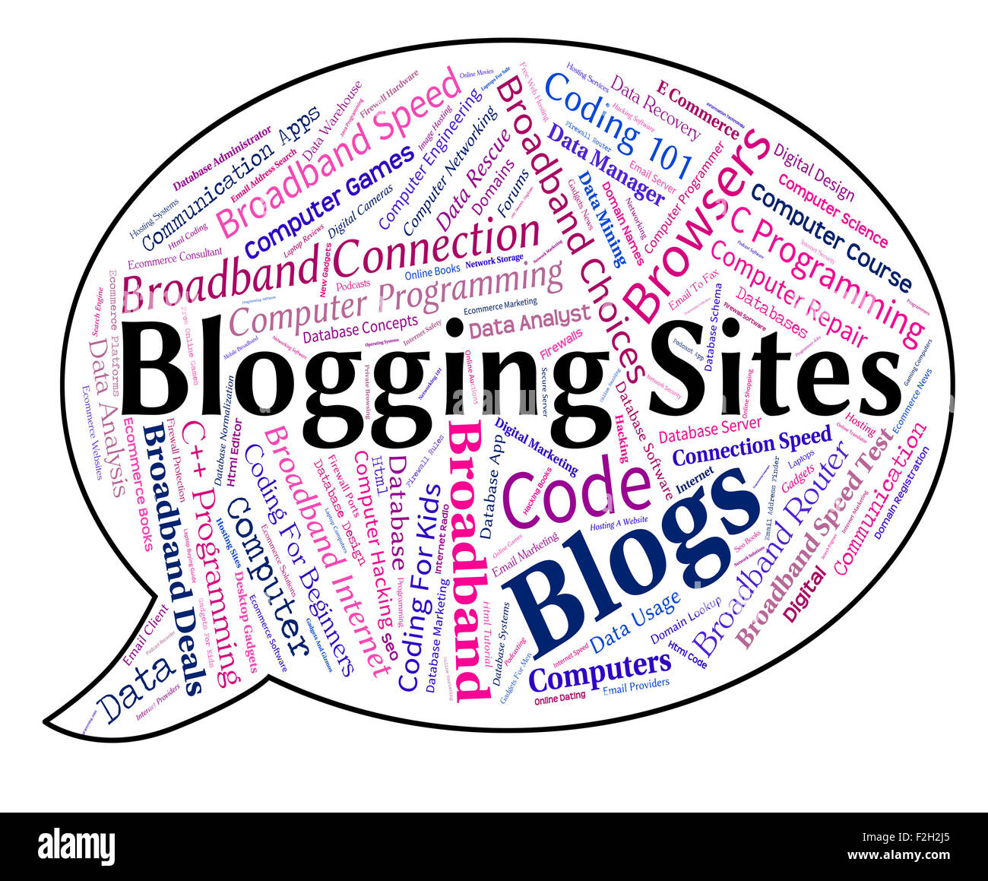
What is blogging?
Blogging is the process that implies creating articles, photos, and other forms
of content and publishing them on a website.
Its characteristics include informal language, a laid-back atmosphere, regular updates,
lifehacks, tips, and a high level of customer engagement.
In simple words, a blog is a website where people can post their thoughts and opinions on a
variety of topics.
A blog is an online journal where you can share your expertise and ideas. A blog MOSTLY
focuses on written content (popularly known as blog posts). Blog posts are usually written in
an informal or conversational style.

Slide 5
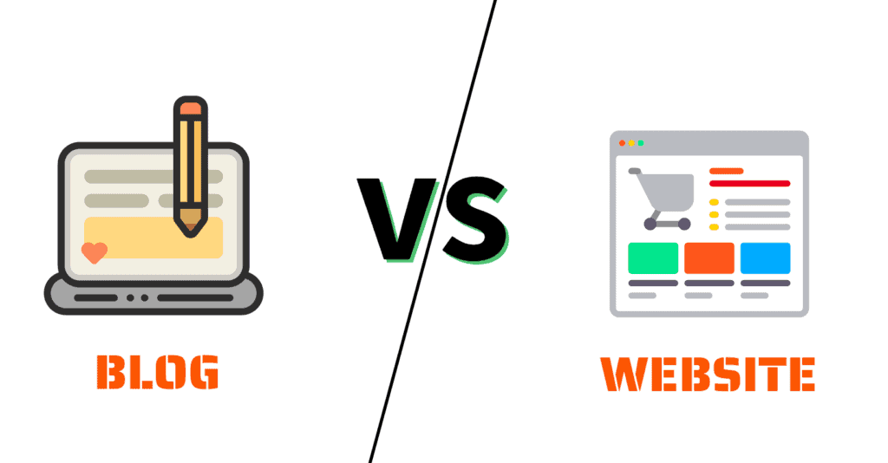
Difference Between a Blog and a Website
There are major differences between a blog and a website. But the most significant one is this –

Slide 6
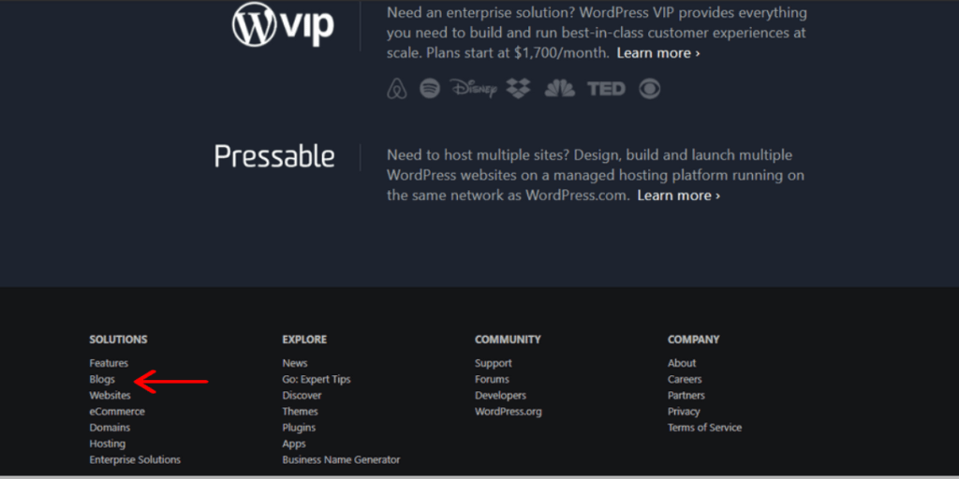
All blogs are websites, but not all websites are blogs
Yes, a blog can be a section (sub-domain) of your website or exists independently.
If you’ve noticed, the websites of reputed companies or brands always have a ‘Blog’ column on their home page.
For example, this is the homepage of WordPress.com. If you scroll to the bottom, you will find a link to their Blog section.

Slide 7
Blogs are frequently updated
A blog is more dynamic, while websites are mostly static. New content is added on blogs regularly, and some bloggers even publish multiple posts in a day!
Websites display information; Blogs display a variety of content
Websites are more inclined towards providing information about their products/services. They use web pages to create a structure and layout to display information effectively.
Blogs promote discussions
Blogs comprise a comments section to promote interaction among the readers and build an online community.
A website is more formal. It is more focused towards communicating its content, product, or service. You won’t find a comments section, but you can send them mails or contact their customer support.

Slide 8
How Does Blogging Work?
So how does blogging work?
In order to start blogging, you will need to create an account on a blogging platform such as WordPress or Blogger.
Once you have set up your account, you can start writing posts and publishing them online.
You can also add pictures and videos to your blog, and share links to your posts on social media sites such as Facebook and Twitter.
Once you have an audience or generate traffic from your blog, you may be able to make money from blogging in various ways including;
Selling affiliate products
Selling your own products
Using display ads such as AdSense, Mediavine, Media.net, etc

Slide 9
Build and improve skills:
Blogging can help you build and improve a number of skills, including:
Writing skills, as blogging requires you to write and publish new blog posts regularly
Editing skills, as you will need to edit your own work, which can help you develop your editing skills.
SEO skills, as you need more traffic to your website, so you will need to learn about SEO (search engine optimization). It is also one of the high-income skills that can teach you how to rank your website on top of Google.
Social media skills, as you will need to be active on social media, which ultimately helps you learn how to use social media effectively for marketing.
Make connections:
With blogging, you can network with other bloggers and influencers in your industry.
You can follow them on social media, reach out through email, and comment on their blog posts. It can ultimately help you build relationships with other professionals and learn from their experiences.

Slide 10
Different Types of Blogs:
There are a gazillion types of blogs out there. Here are some of the common types of blogs that are popular.
Travel blogs are all about sharing your travel adventures with the world.
These blogs are becoming popular, where you’ll find tips on finding the best deals on flights and hotels, must-see attractions, and more.
Personal blogs are written by individual bloggers. You can write about your life, thoughts, and feelings, whatever you want.
Niche blogs focus on a specific topic, such as weight loss, parenting, lifestyle, etc. They often target high CPC keywords to make money from affiliate ads or display ads.
Lifestyle or fashion blogs cover the latest fashion, beauty, and lifestyle trends.
Health blogs mostly write about health and wellness topics like nutrition, fitness, and mental health.
Corporate blogs often are used by big brands that cover news and updates about their company, products, and services. Semrush blog is the best example.

Slide 11
Major Blogging Platforms
WordPress
Medium
Blogger
Wix
Weebly
How to create your own blog?
Step 1: Choose a blogging platform: There are many different blogging platforms available, such as WordPress, Blogger, and Wix. Do some research to find the platform that best suits your needs. We ALWAYS recommend WordPress.org as it is SEO-friendly and easy to use.
Step 2: Pick a domain name: Once you’ve chosen a blogging platform, you’ll need to pick a domain name for your blog. This is what people will use to access your site. Choose something catchy and easy to remember.
Step 3: Set up your blog: Choose a web host (if you’re using WordPress) and select a theme or template, and customize your site’s appearance.
Once everything’s done, you’re ready to start publishing content. Write about topics that you’re passionate about, and be sure to update your blog regularly with new posts if you want to get noticed.

Slide 12
Defining API Endpoints
Resource-Based
Endpoints should be designed based on the resources being accessed, such as "posts," "comments," or "users."
Consistent Structure
Use a consistent format for defining endpoints, such as "/posts," "/posts/{id}," or "/users/{username}."
Versioning
Implement versioning to allow for API updates without breaking existing applications. For example, "/api/v1/posts" or "/api/v2/posts."

Slide 13
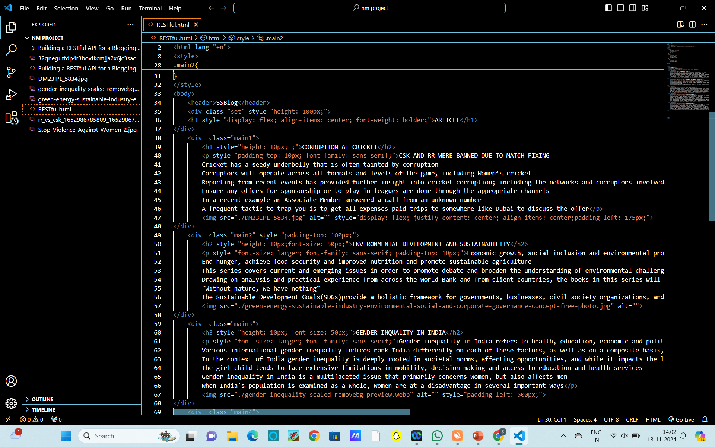
Code for RESTful API

Slide 14
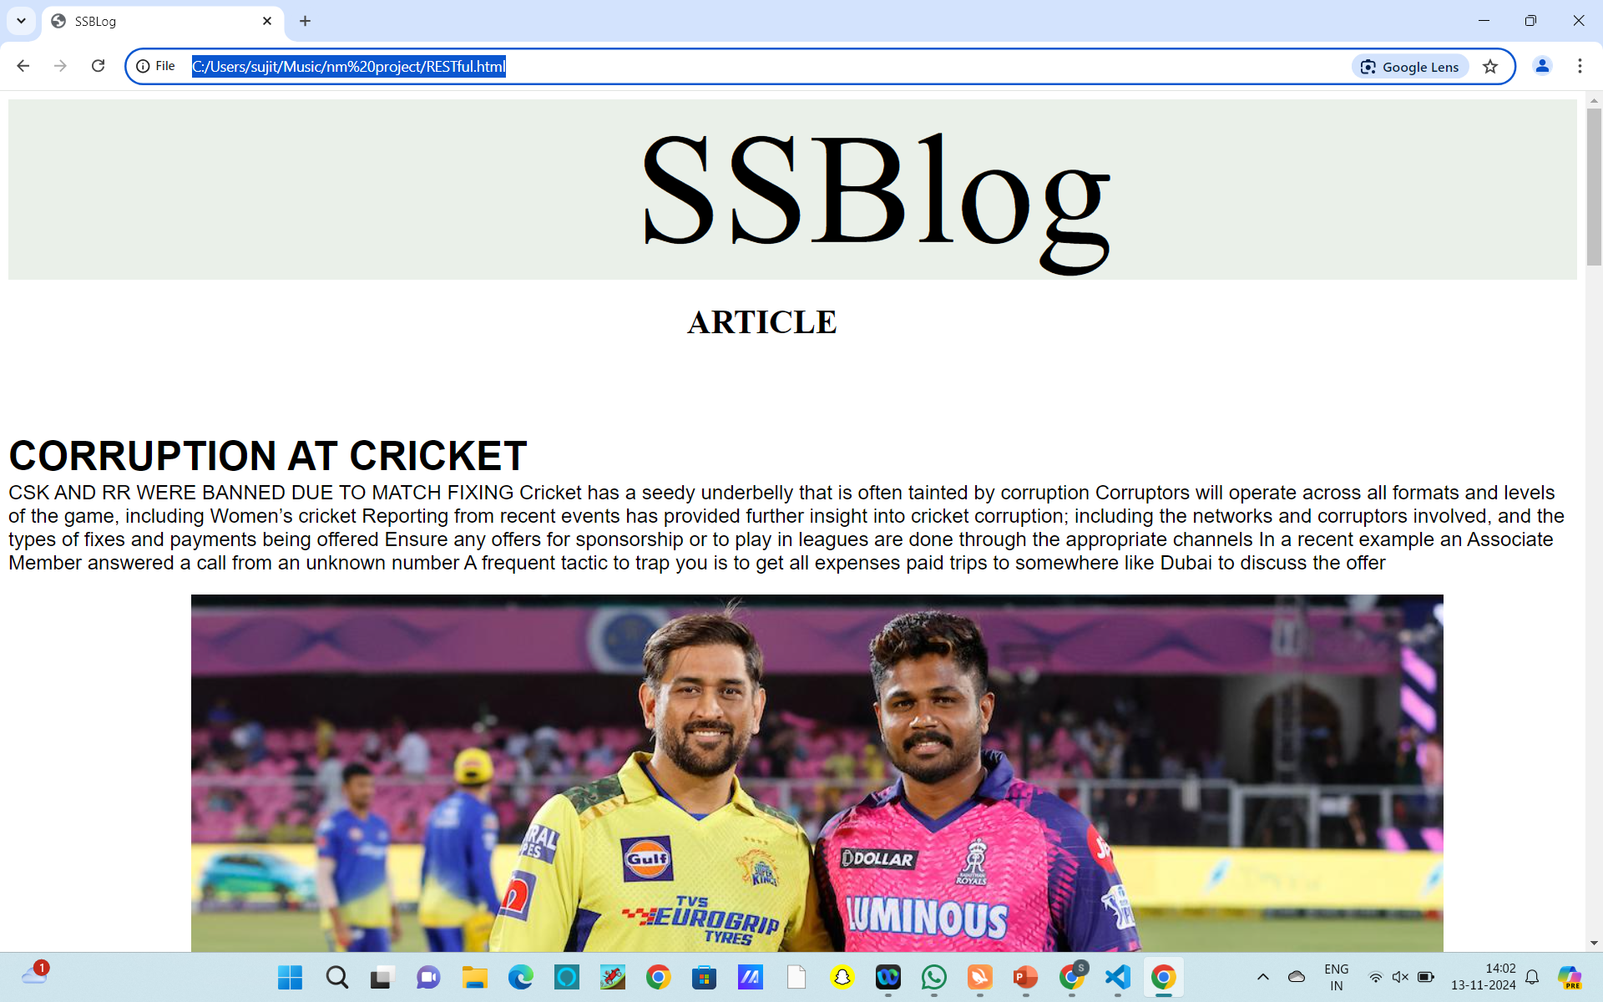
Output

Slide 15


